Slide 1

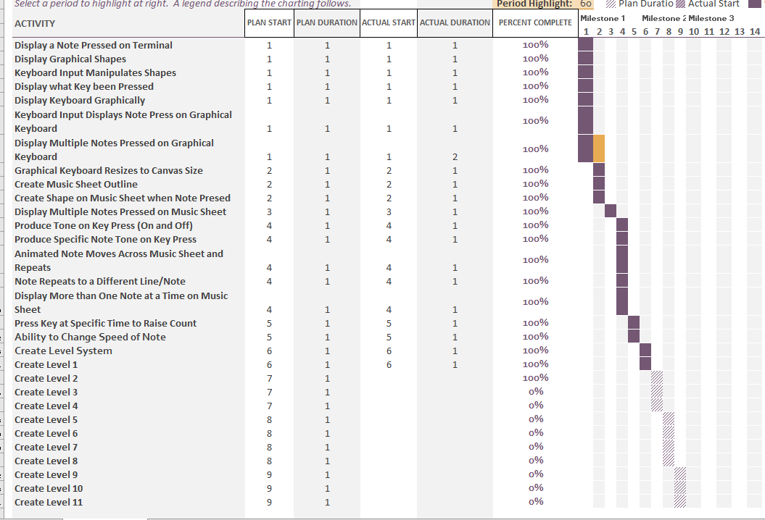
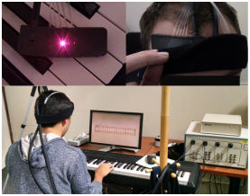
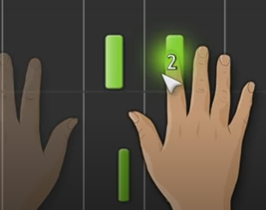
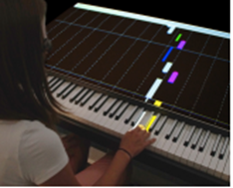
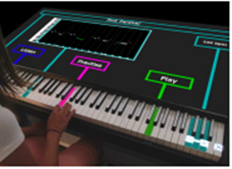
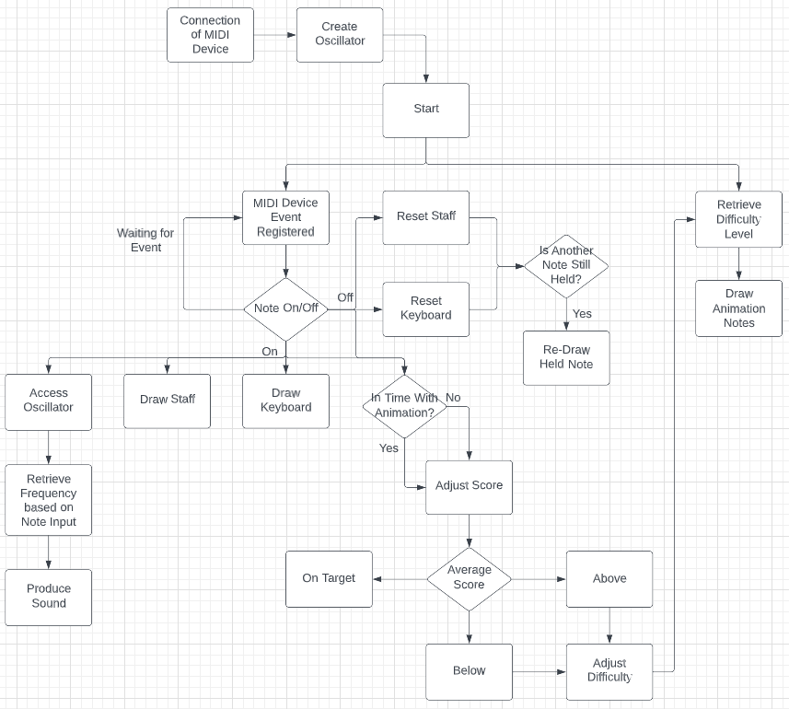

Creating a Responsive and Dynamic Piano Education Tool
Kieran Best
Research
Research proves that we learn better once we reach a “zone of proximal development” (Walker, R.A., 2010) which is better accessed through a Intelligent Tutoring System in which the lesson is responsive as opposed to a linear taught lesson (Yuksel et al., 2016) (Graesser, A.C. et al., 2012). Responsive lessons are adaptive to a users ability and reinforce the theory to human learning (Skinner, 2012) whereas a linear lesson is taught with a pre-planned path.
Similar Applications
Basic applications that teach using a linear path through the use of video tutorials to teach songs or how to read music such as ‘Harmony City’ and ‘Tenuto’ (Educational App Store, 2022).
My Project
To create an application that teaches users to how to read and play sheet music on a piano using a MIDI keyboard.
The application will keep score on whether the user is hitting the note on time or not and adjust the speed and difficulty based on this to enable users to reach the ‘zone of proximal development’.
It will be built by using JavaScript within HTML allowing ease of access if it were to be made a commonly accessible application. It would be accessible in all browsers that enable the capability of MIDI device input such as Edge, Chrome and Opera.
Project Management
Creating this project will be done so using the Agile approach, the project will be split into 3 milestones each with bi-weekly sprints. The reviews at the end of each milestone will evaluate a Minimum Viable Product (MVP) and set new objectives by allowing user feedback from a varied audience to attain new scope for the development of the project. The varied audience will consist of both music literate and illiterate individuals.
‘BACh’ is an application that measures users cognitive ability using a fNIRS sensor to adapt the lesson and allow the user to reach a ‘zone of proximal development’ (Yuksel et al., 2016).
‘Synthesia’ uses a MIDI keyboard input and has a note visualisation like ‘P.I.A.N.O.’. It contains a mass library of songs for users to learn, and also contains helpful hints for hand placement called “Finger Number Hints” (Synthesia Game, 2022).
‘P.I.A.N.O.’ has an interactive visualisation of the keyboard to help understand key notes on the keyboard and where users hands should be. It also has a rolling note visualiser for learning how to read music (Rogers et al., 2014).
Statistical Analysis for Level Progression
Dominant Hand, Without Moving Hand
Less Dominant Hand, Introduce Sharps and Flats in the Octave
Play Across Both Hands
Dominant Hand, Move Hand Across 1 Octave
Dominant Hand, Introduce Sharps and Flats in the Octave
Swap to Less Dominant Hand, Without Moving Hand
Less Dominant Hand, Move Hand Across 1 Octave
Dominant Hand, Introduce 3 Note Chords
Less Dominant Hand, Introduce 3 Note Chords
Play Across Both Hands, Introducing New Chords
Play Across Both Hands
The frequency of generation of notes will be determined by that of the players accuracy. A player cannot progress onto a harder difficulty without attaining a level of accuracy over a duration of notes.
The short term benefits of this are that it enables a dynamic difficulty enabling the user to reach the ‘zone of proximal development’.
Long term benefits include:
The ability to measure progress over time
Potential to be linked to piano grades and provide a rough idea as to the grade you are currently performing at.
Conditional Flow Diagram
All actions for the application are dependent on the MIDI device input:
The sound comes from the note input being registered as a number from the MIDI device input.
The visual representation on both the keyboard and the staff comes from the note number given by the MIDI device input.
The difficulty is adjusted based on the users’ score.
References
Graesser, A.C. et al.(2012) ‘Intelligent tutoring systems’, APA educational psychology handbook, pp. 451-473.
Rogers, K. et al. (2014) ‘P.I.A.N.O.: Faster Piano Learning with Interactive Projection’, Proceedings of the Ninth ACM International Conference on Interactive Tabletops and Surfaces, pp. 149-158.
Skinner, B. (2012) ‘The science of learning and the art of teaching’, Educational Psychology, 66, pp. 301.
Synthesia (2022) Synthesia Game Available at: https://synthesiagame.com/ (Accessed: 30/11/2022)
Walker, R.A. (2010) ‘Sociocultural issues in motivation’, Social and emotional aspects of learning, pp.712-717.
Yuksel, B.F. et al. (2016) ‘Learn piano with BACh: An adaptive learning interface that adjusts task difficulty based on brain state’, Proceedings of the 2016 chi conference on human factors in computing systems, pp. 5372-5384.

